Slide 1
Big Walnut Local School District
March 2015 Financials
3rd Quarter FY2015 Summary
May 2015 Forecast Summary

Slide 2
March Financial Summary
3rd Quarter 2015 Summary- line by line look at forecasted amount and status as of end of March
May 2015 Forecast Summary

Slide 3
State Share Index
Opportunity Grant - $5,800 per student
State Share 22.15%
$1,285 s/b paid by state per student
Calculated = $1285 x 3112 ADM = $ 3,998,128
Opportunity Grant - $5,800 per student
Local Share 77.85%
$4,515 paid by local tax dollars
Capped Opportunity Grant Funding $ 3,292,471
Divided by FY15 ADM 3,112
Opportunity Grant $1,058 - Actually funded by state per ADM
$ 4,742 – Paid by local tax dollars
$,5,800

Slide 4
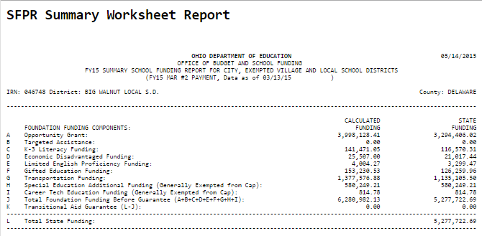
FY 15 State Funding Calculated vs. Funded
Core Aid = $5800 x 22.15% State Share Index
Calculated
$1285 per ADM
Funded
$1058 per
ADM

Slide 5
FY2015 Capped Unrestricted State Funding = $5,256,543 FY15 Total ADM = 3112

Slide 6
Big Walnut Local Schools All Revenue

Slide 7
Big Walnut Local School District
May 2015
Five Year Forecast

Slide 8
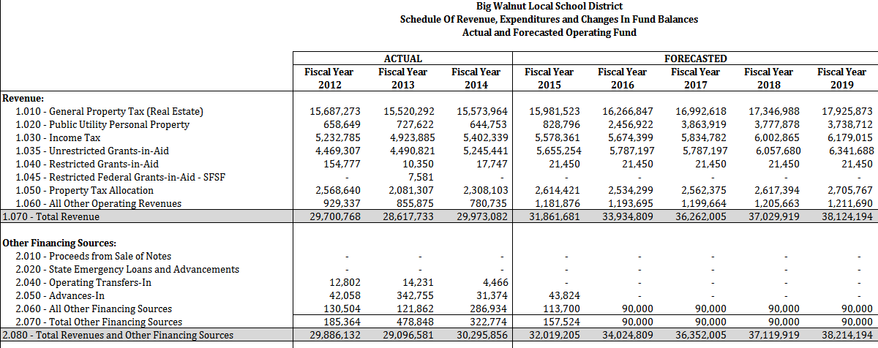
May 2015 Five Year Forecast Revenue

Slide 9
May 2015 Forecast Line 1.01 – General Property Tax (Real Estate) Average annual increase of just over 4%

Slide 10
May 2015 Five Year Forecast Revenue

Slide 11
May 2015 Forecast Line 1.01 – General Property Tax (Real Estate) Average annual increase of just over 4%

Slide 12
May 2015 Five Year Forecast Revenue

Slide 13
May 2015 Forecast Line 1.03 – Income Tax Average annual increase approximately 3.4%

Slide 14
May 2015 Five Year Forecast Revenue

Slide 15
May 2015 Forecast Line 1.035 - State Funding Average Annual Increase 1.6%

Slide 16
May 2015 Five Year Forecast Revenue

Slide 17
May 2015 Forecast Line 1.01 – General Property Tax (Real Estate) Average annual increase of just over 4%

Slide 18
May 2015 Five Year Forecast Revenue

Slide 19
May 2015 Five Year Forecast Revenue

Slide 20
May 2015 Five Year Forecast Revenue

Slide 21
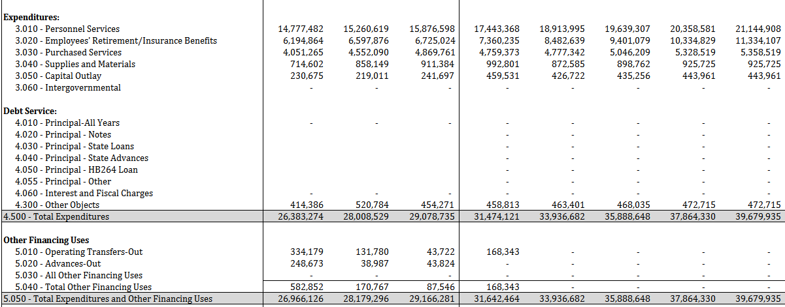
May 2015 Five Year Forecast Expenditures

Slide 22
May 2015 Five Year Forecast Expenditures

Slide 23
May 2015 Five Year Forecast Expenditures

Slide 24
May 2015 Five Year Forecast Expenditures

Slide 25
May 2015 Five Year Forecast Expenditures

Slide 26
May 2015 Five Year Forecast Expenditures

Slide 27
May 2015 Five Year Forecast Expenditures

Slide 28
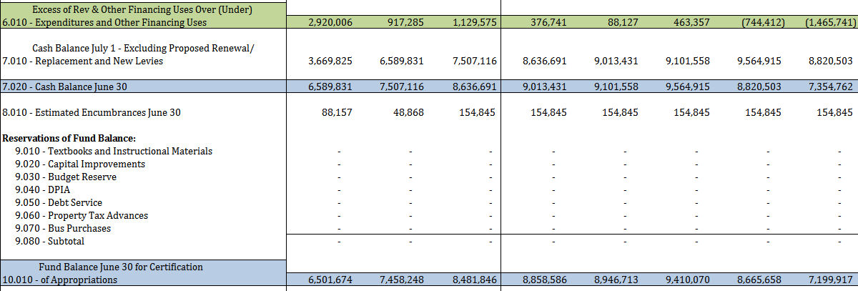
May 2015 Five Year Forecast Balances

Slide 29
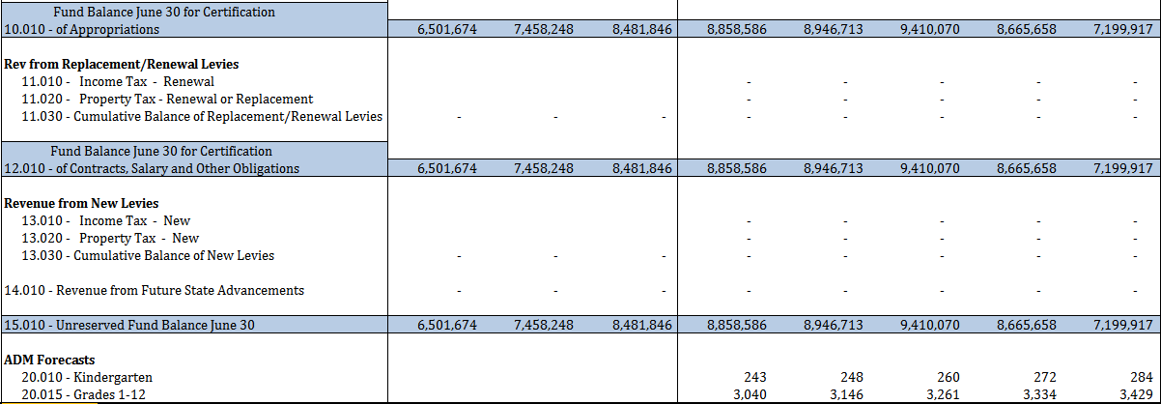
Big Walnut Local Schools Five Year Forecast May 2015

